Slide 1
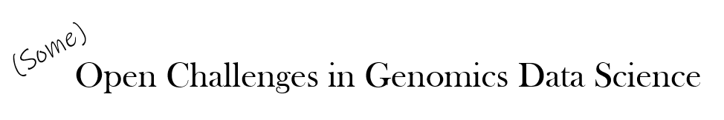
(Some)
Open Challenges in Genomics Data Science

Slide 2
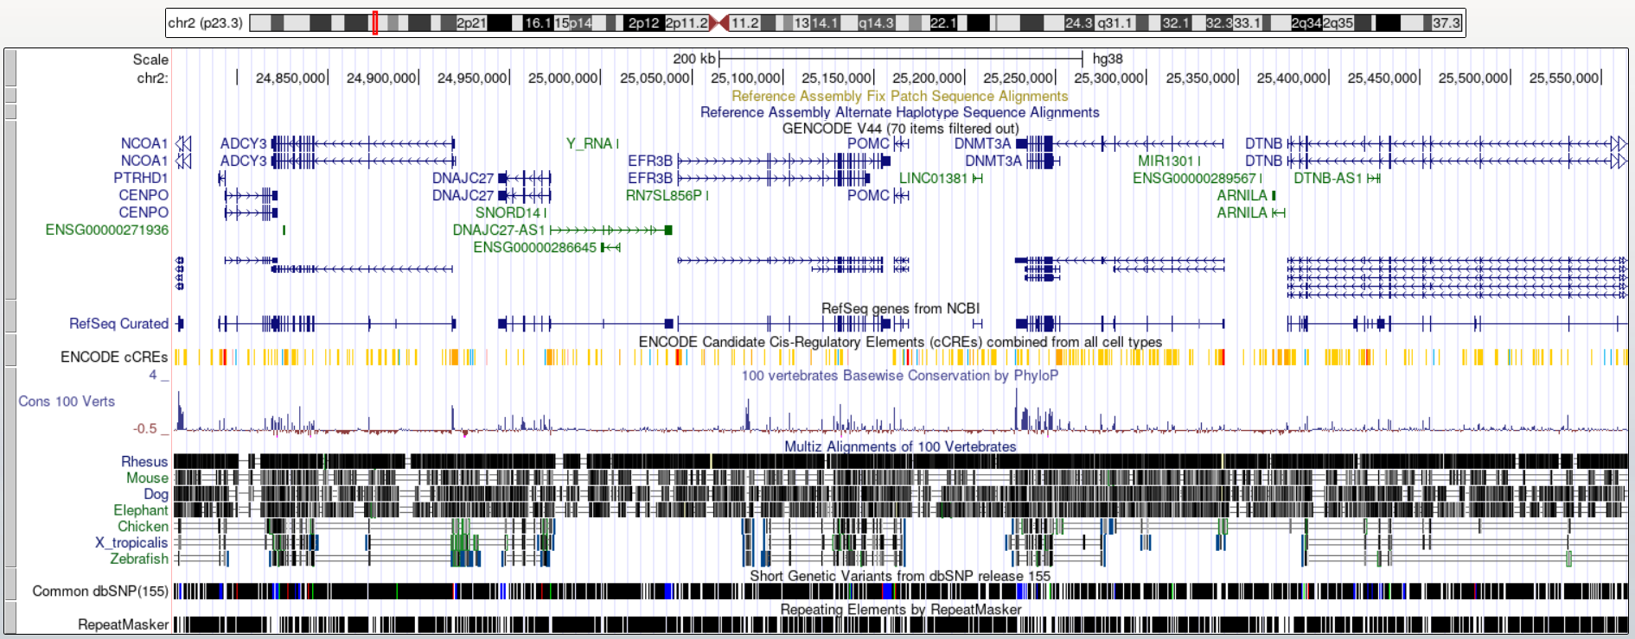
Genomic Annotation
Methods based on evolutionary conservation, sequence patterns, aggregation of experimental results, and others.
Machine Learning methods increasingly used for this purpose.

Slide 3
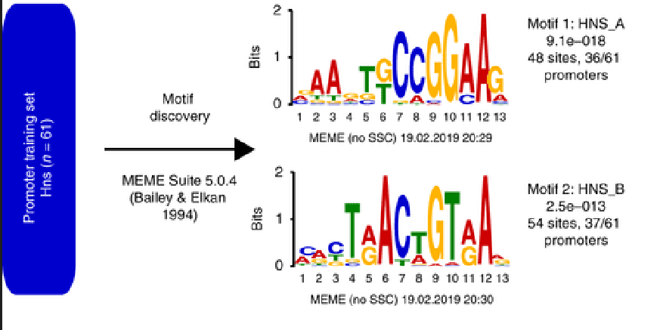
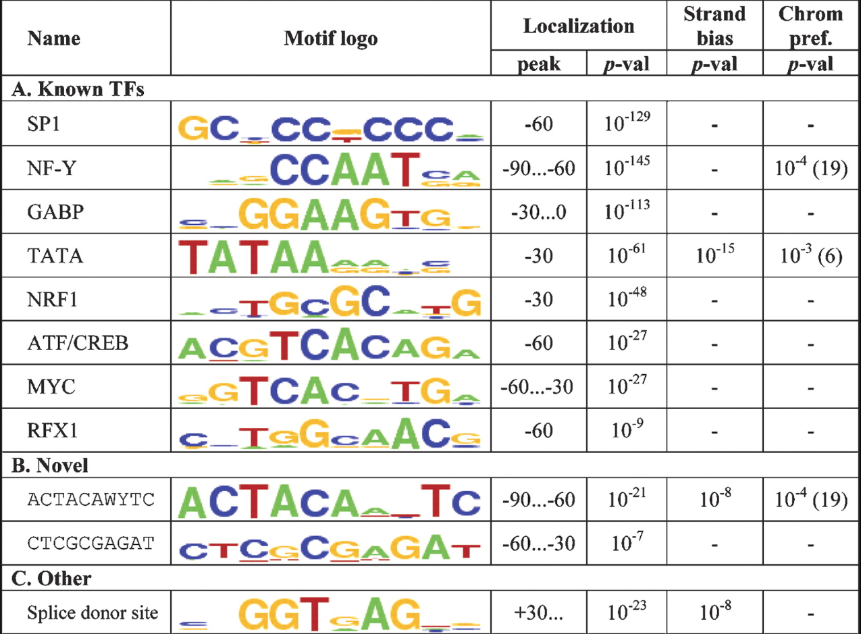
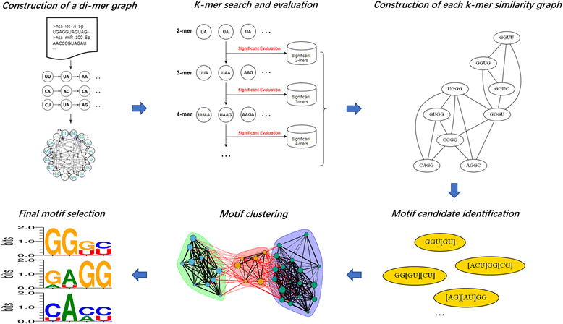
Regulatory Motif Discovery

Slide 4
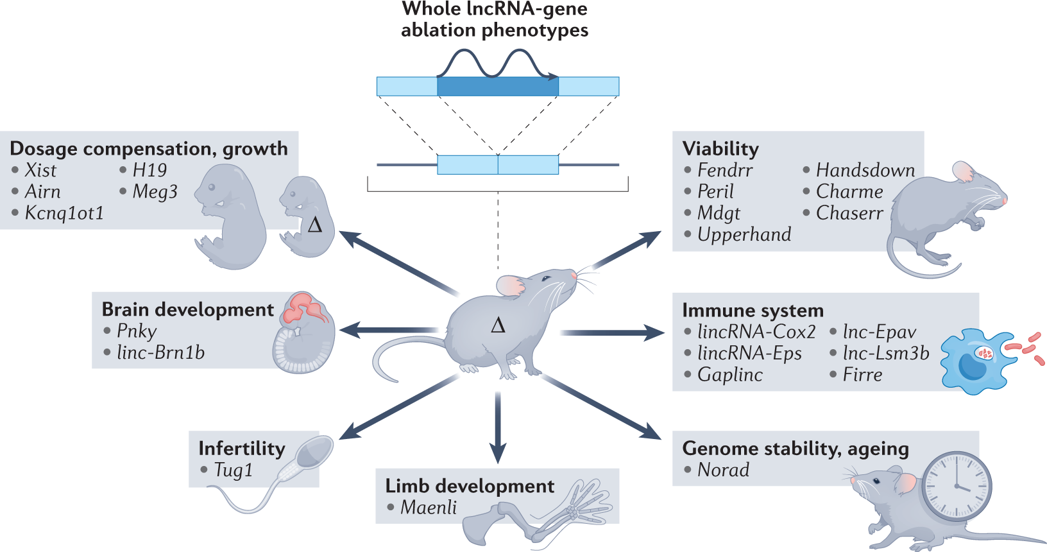
Long non-coding RNAs
Is the ‘language’ of lncRNAs based on sequence, shape, or something else?
What is the ‘syntax’ of this language?

Slide 5
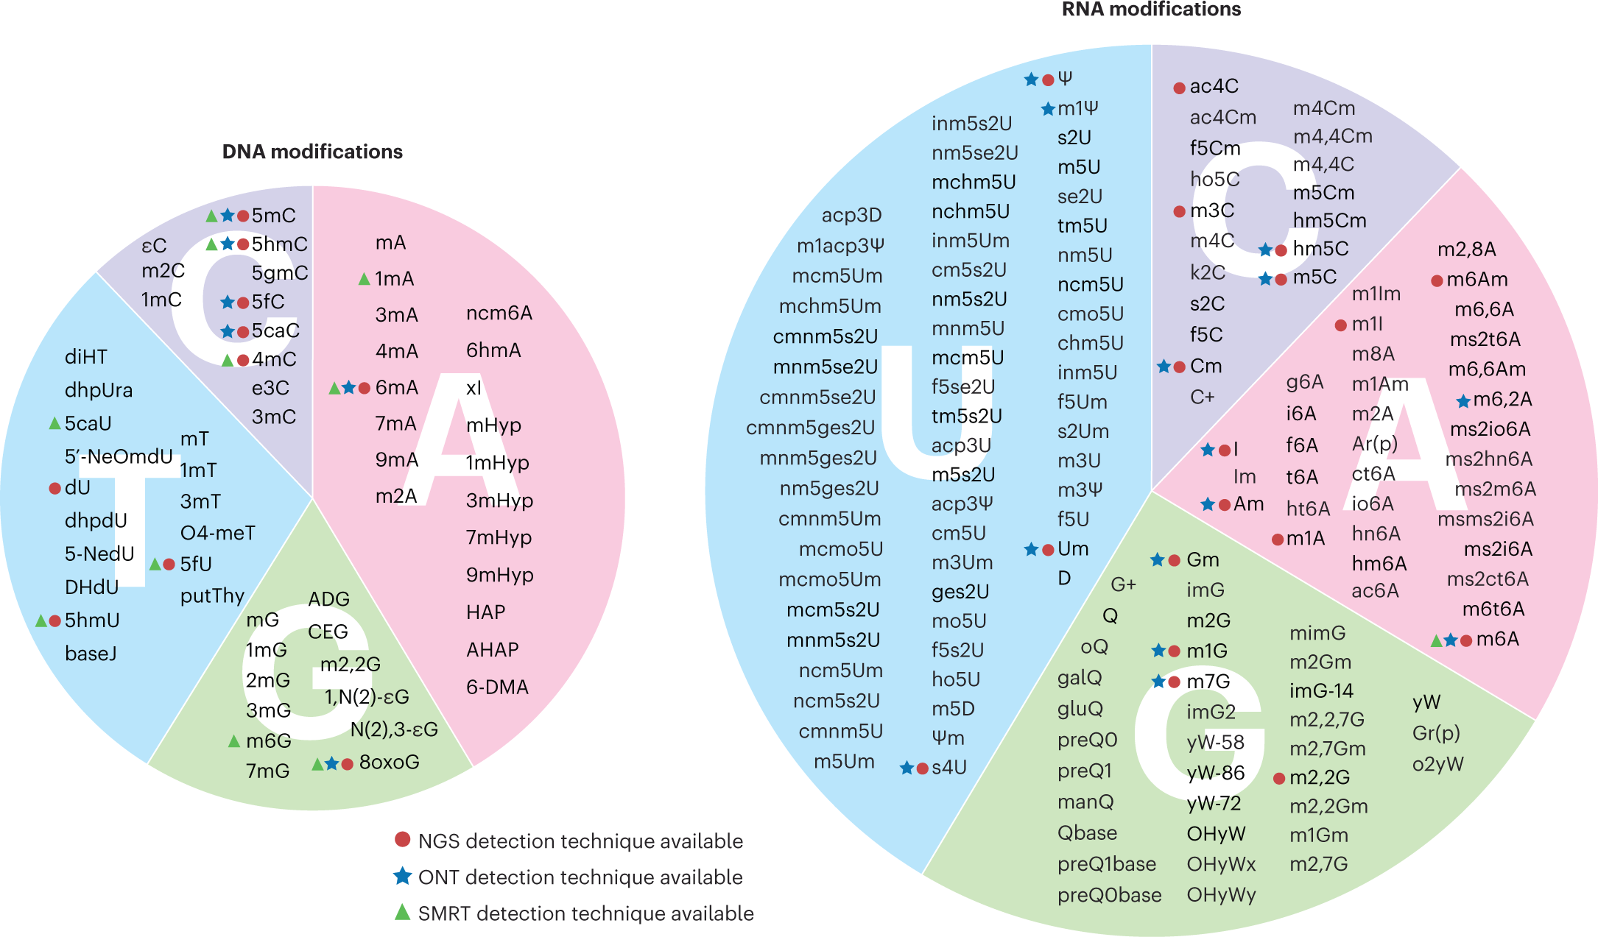
Epigenomics and Epitranscriptomics

Slide 6
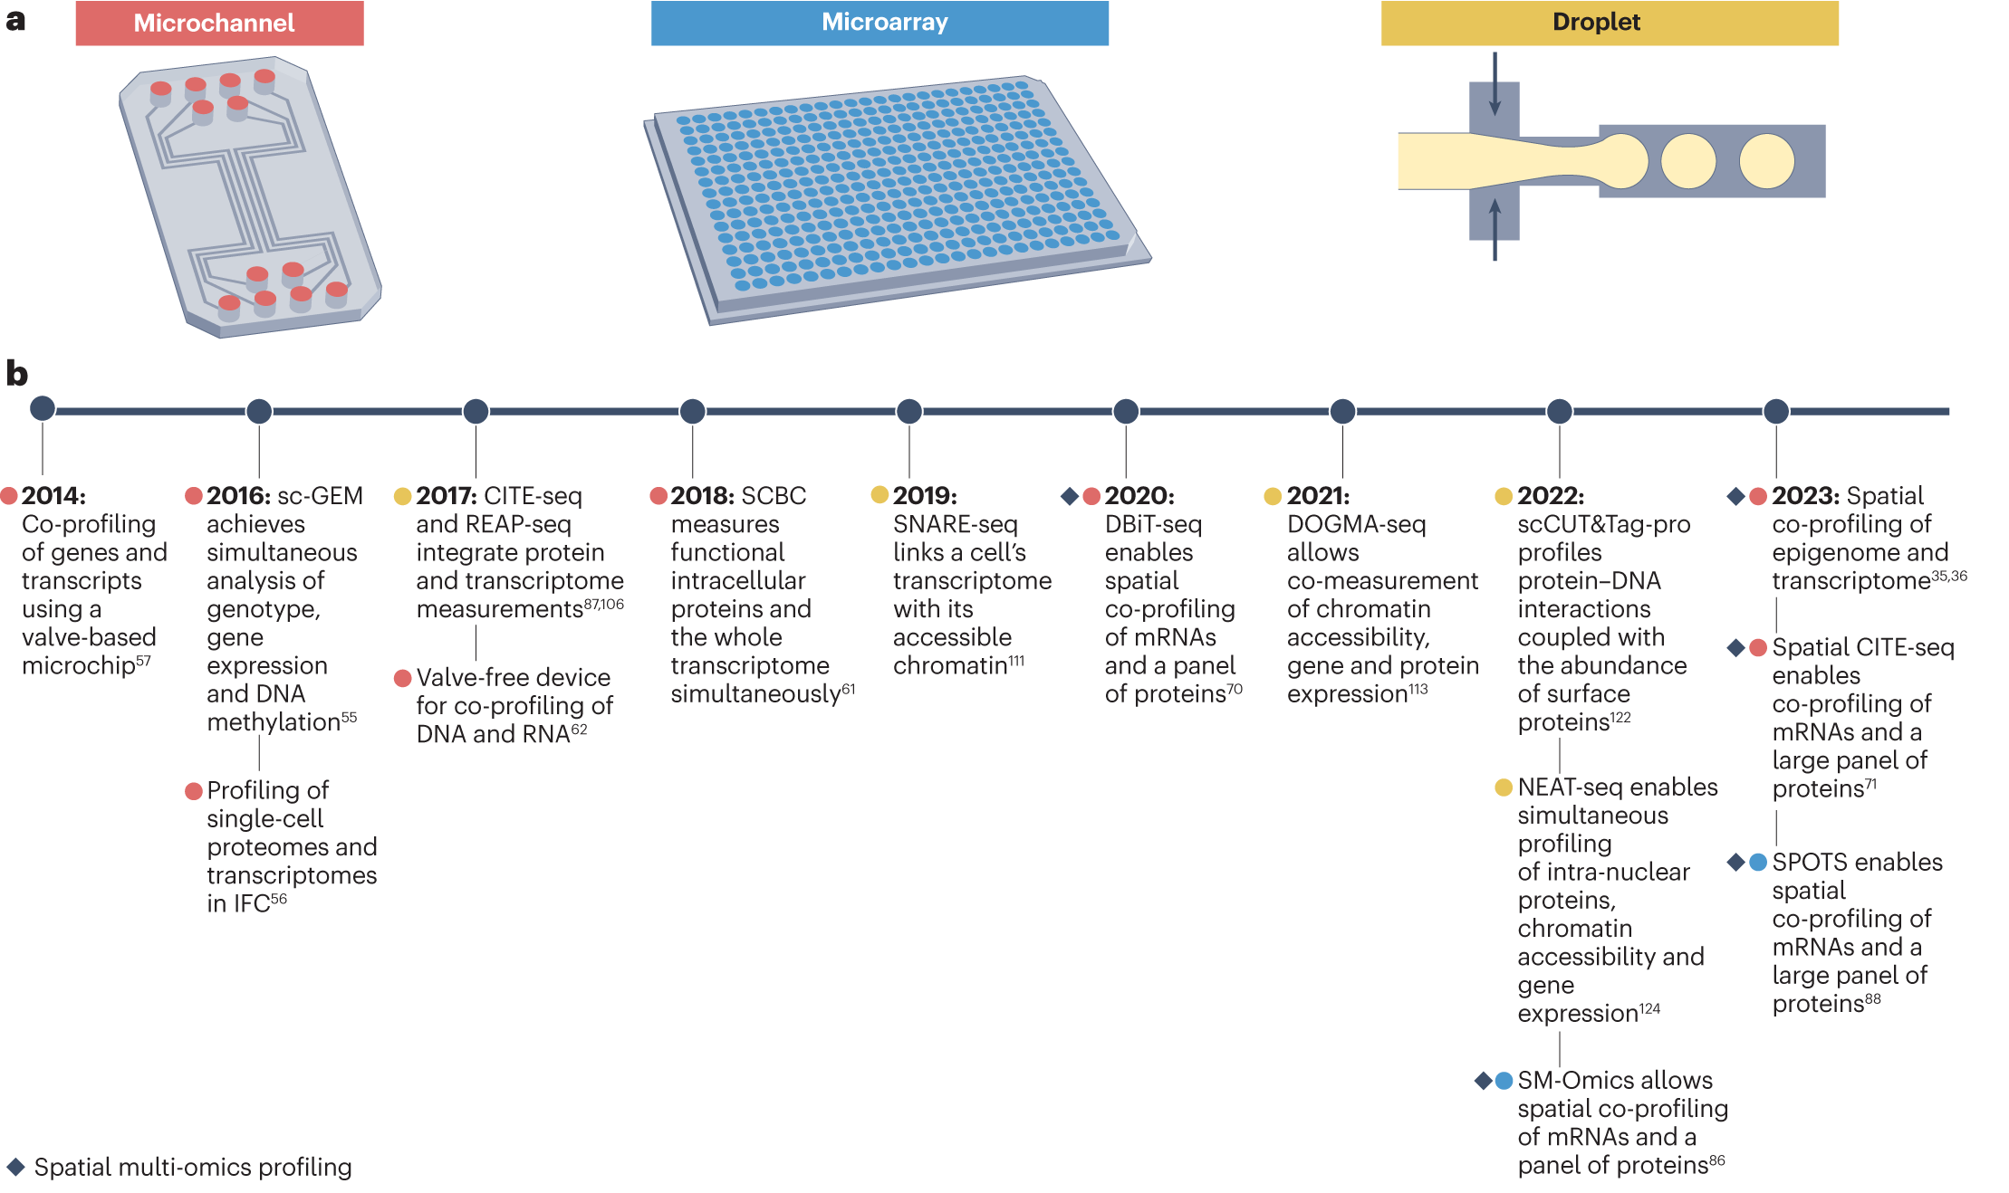
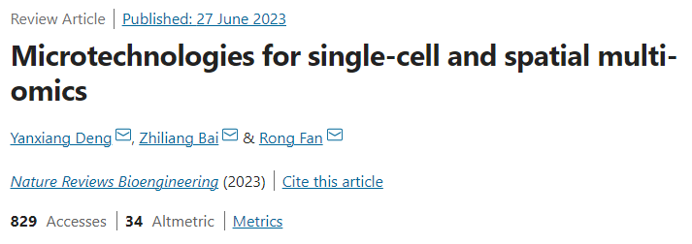

Spatial multi-omics in single cells

Slide 7
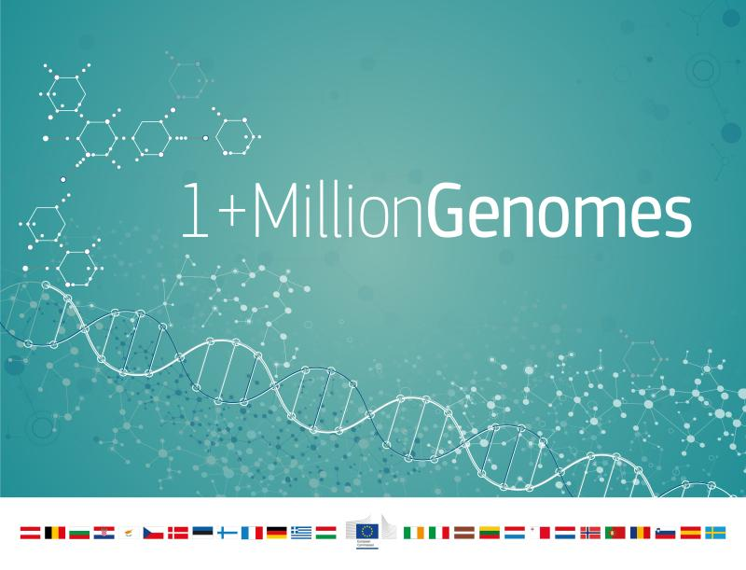
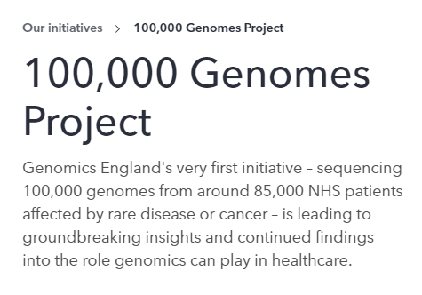


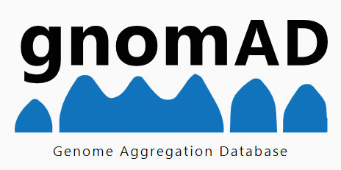

Genome Sequencing at Population Scale

Slide 8
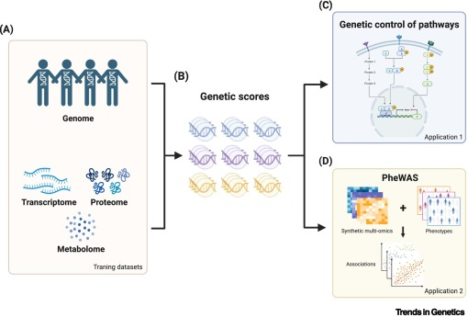
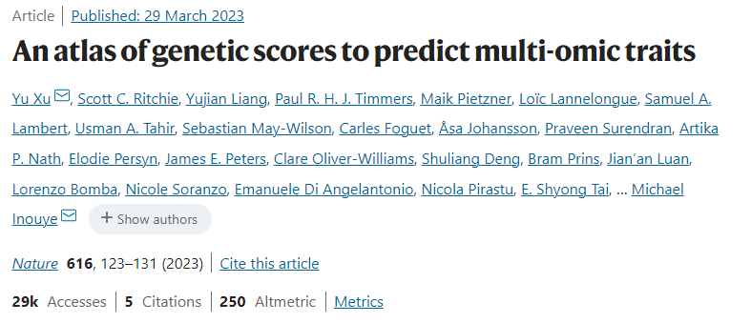
Understanding multifactorial traits / diseases

Slide 9
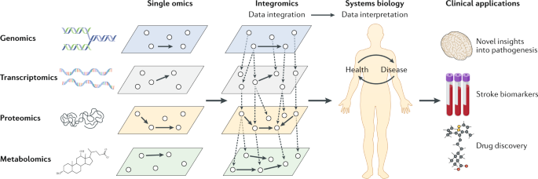
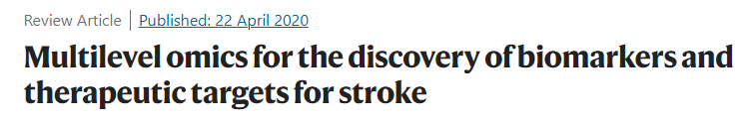
-omics and Medicine

Slide 10
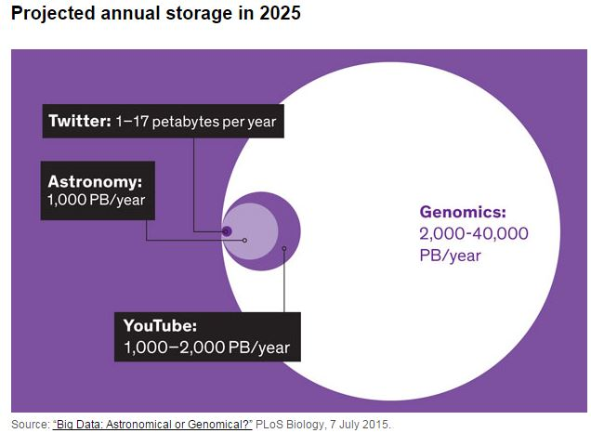

Slide 11
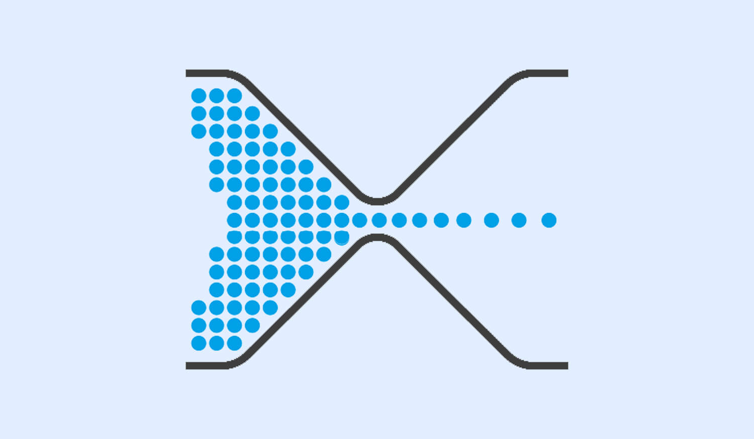
Computational
Power and
Storage
Scientific
Findings
Exabytes of
Genomic Data
Trained and
Efficient
Bioinformaticians
(-omic Data Scientists)

Slide 12
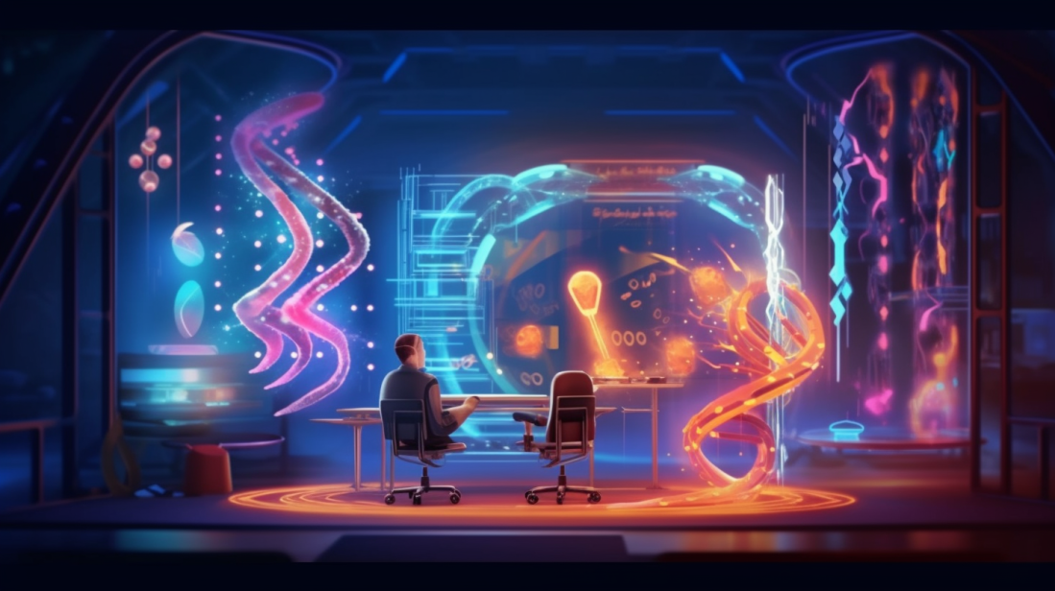
Machine Learning and
Genomics Data Science

Slide 13
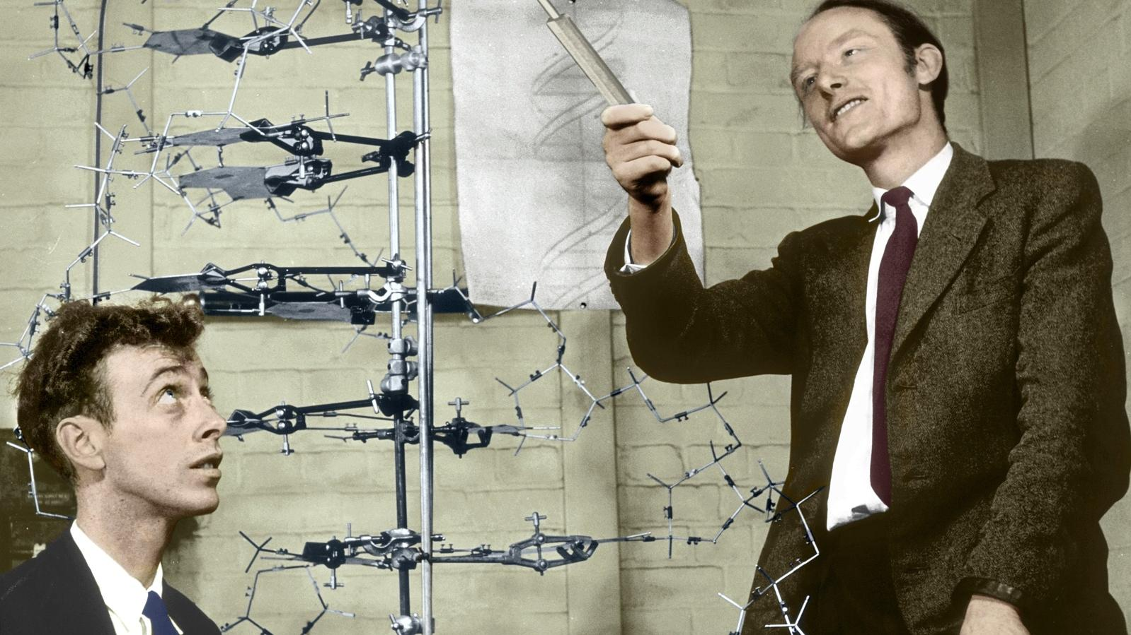
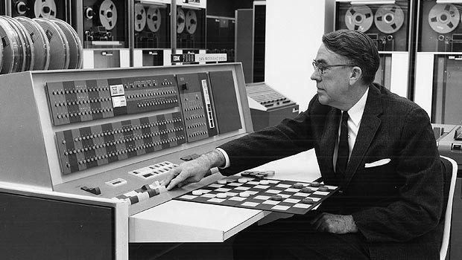
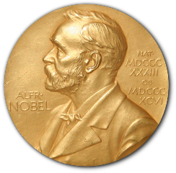
1962
Francis Crick identified himself as a molecular biologist as a way of shortening his previous description of himself as "a mixture of a crystallographer, biophysicist, biochemist, and geneticist.”
Arthur Samuel of IBM developed a computer program for playing checkers. The program used a scoring function to assess moves, and learned from previous games.
1950s – Discovery of DNA structure
1950s – First Machine Learning

Slide 14
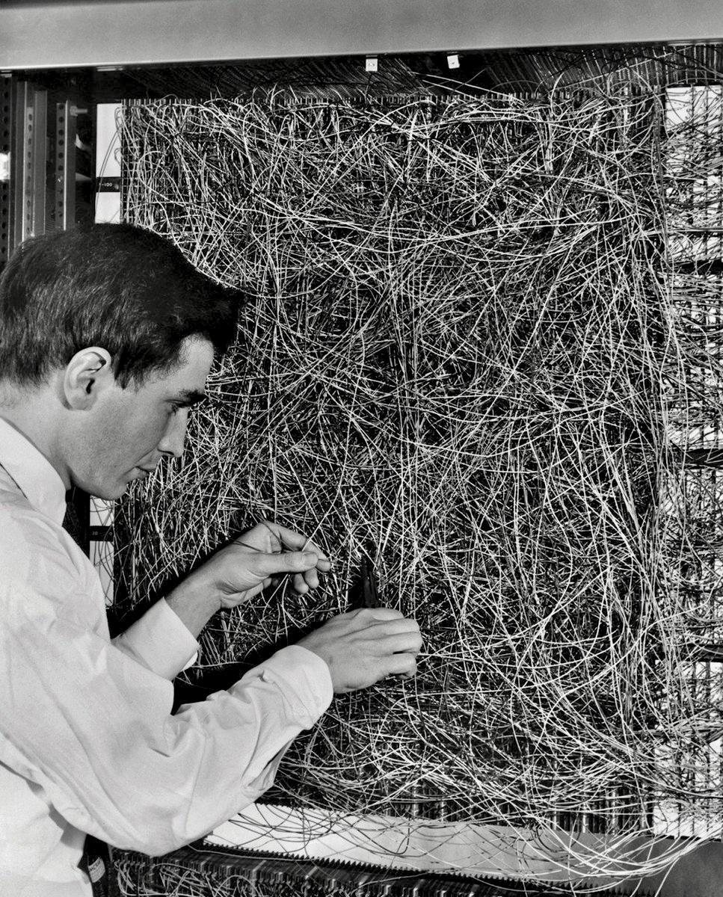
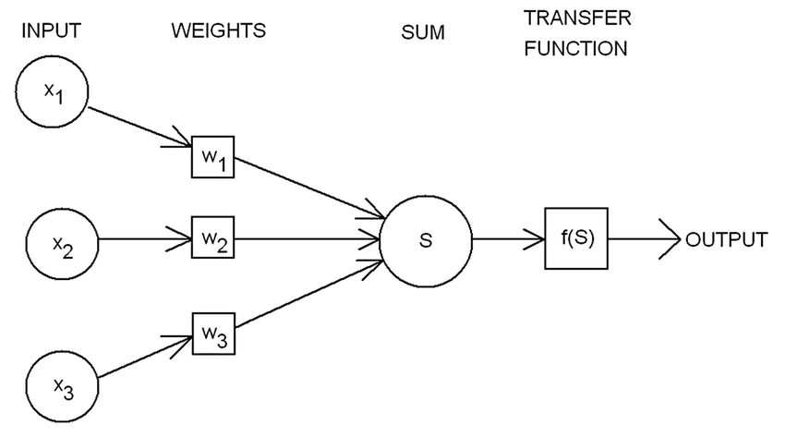
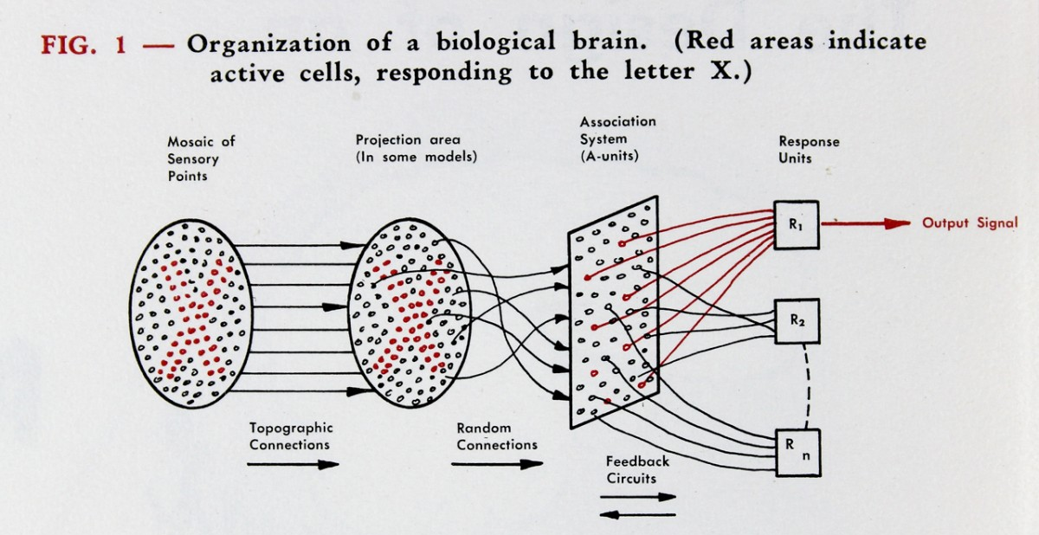
Perceptrons may eventually be able to learn, make decisions,
and translate languages
1950s – Mark I Perceptron
First Artificial Neural Network

Slide 15

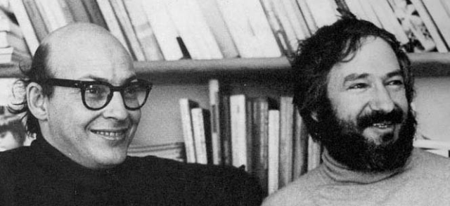
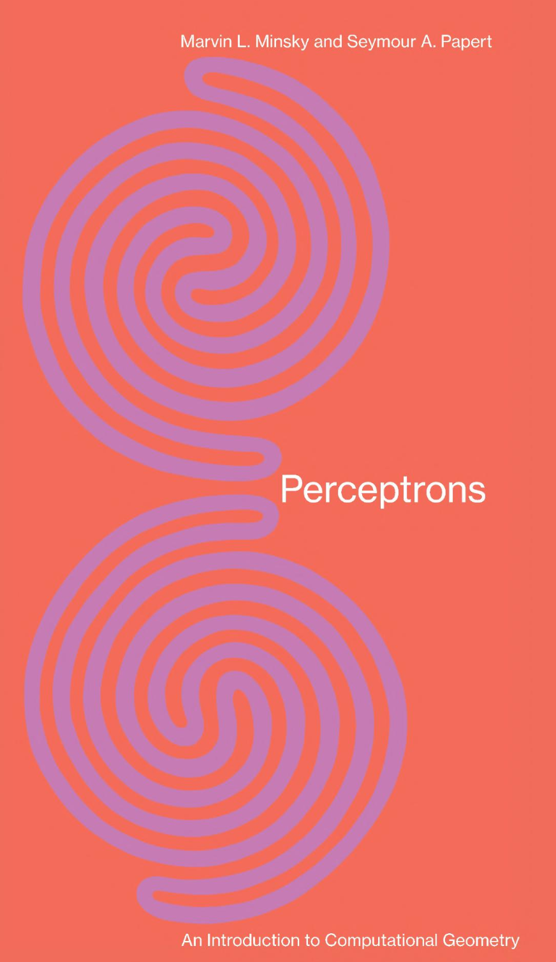
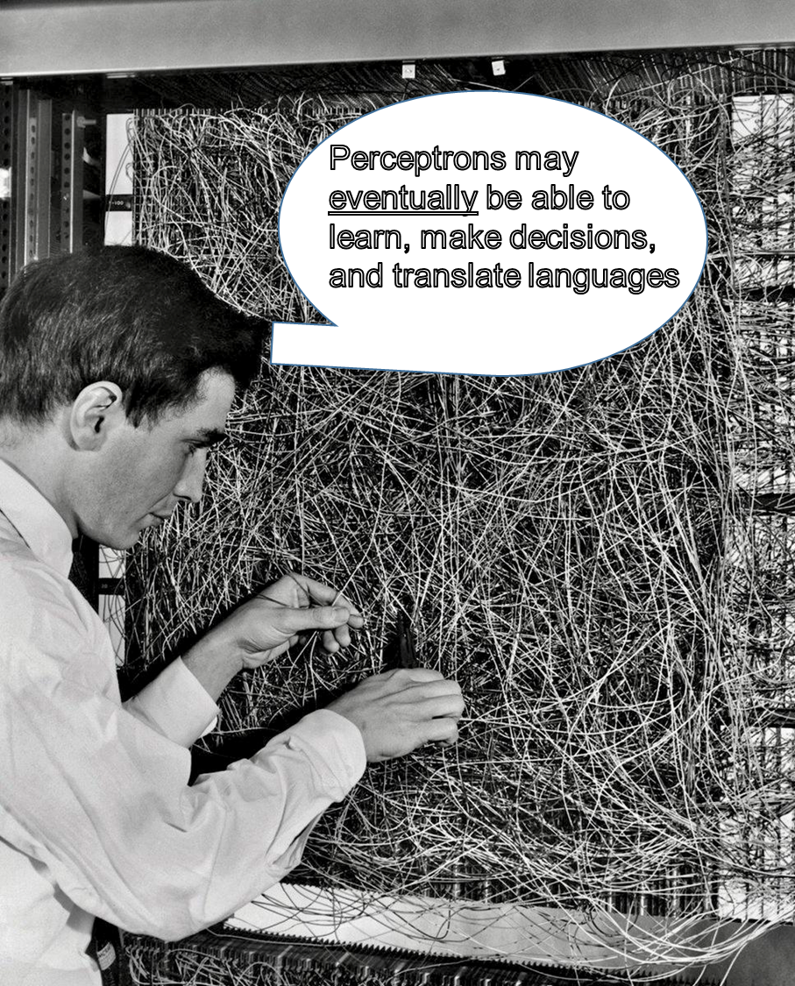
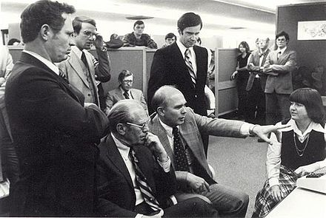
Non-linearly separable functions problem
Late 1960s –
First AI Winter
No, they can’t.
and we can prove it
Minsky
Papert
Mr. President,
Our Russian translation
AI needs another 50 years
of development…

Slide 16
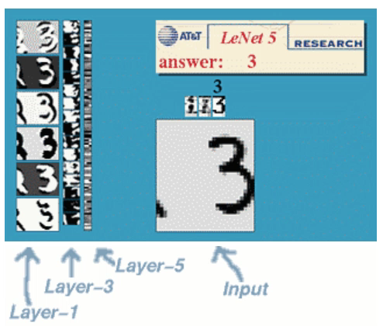
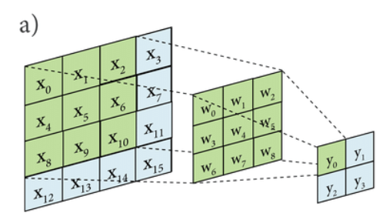


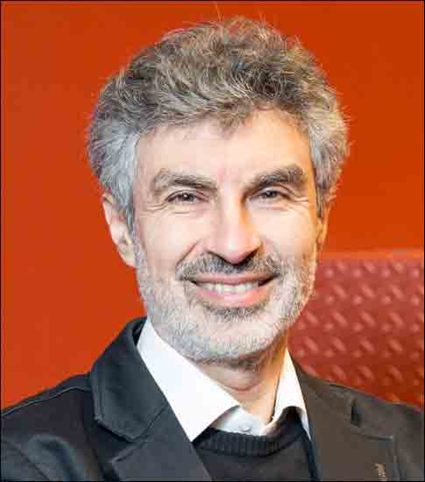
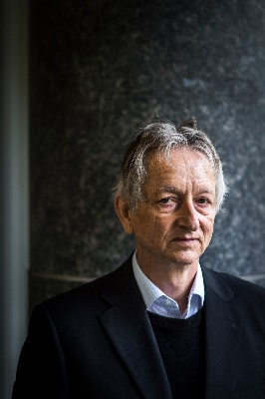
1990s – Convolutional Neural Network
https://playground.tensorflow.org/
Yann LeCun
Yoshua Bengio
Geoffrey Hinton

Slide 17
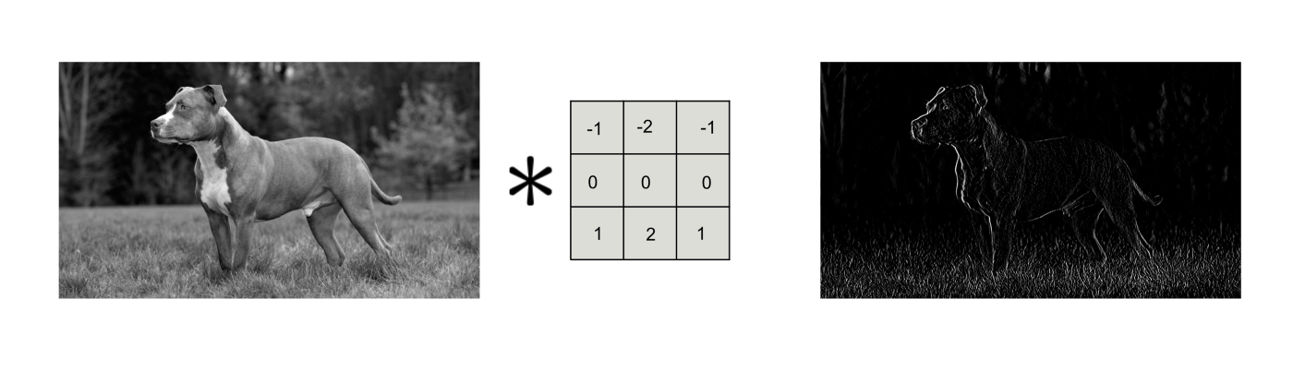
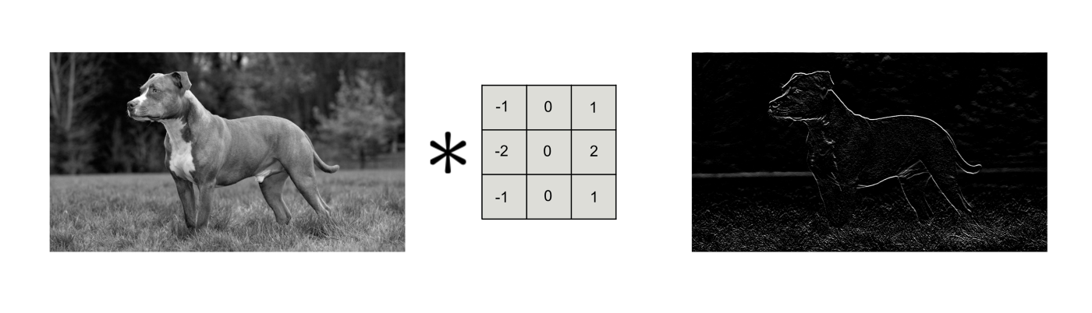

Slide 18
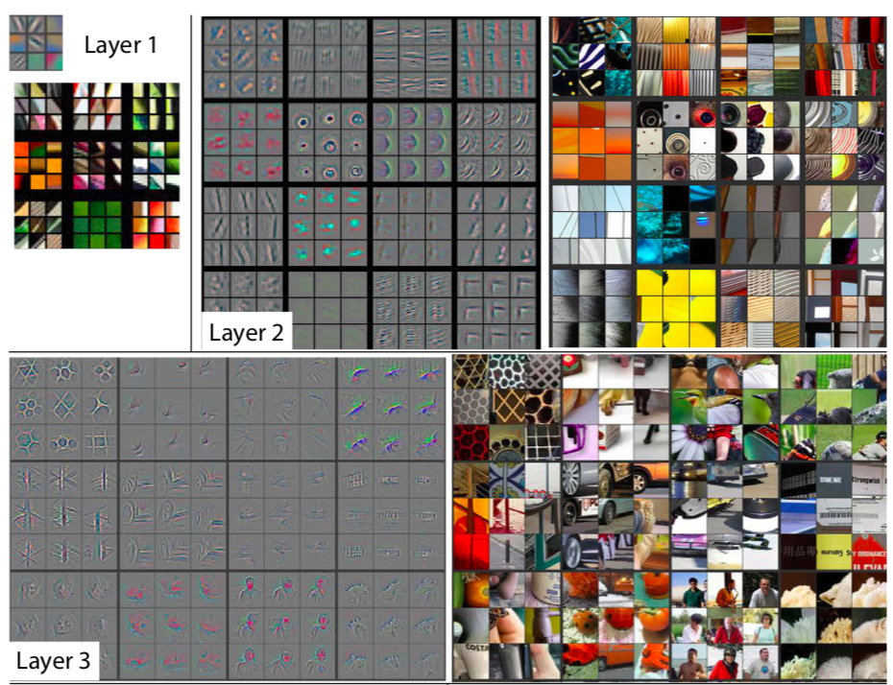
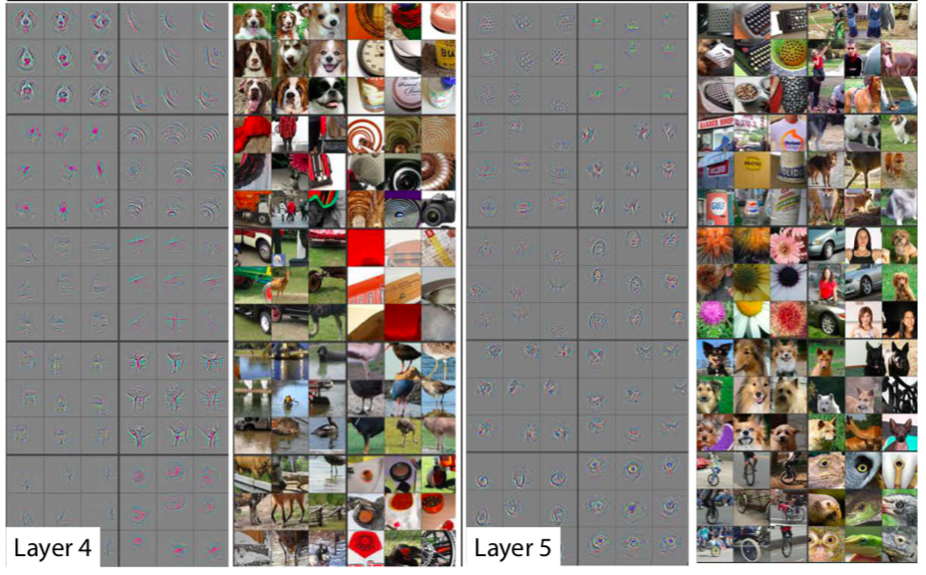
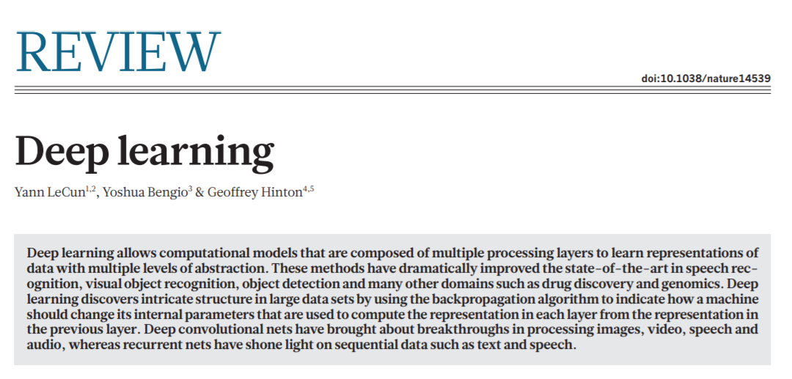

2015 – Deep Learning Revolution
Yann LeCun
Yoshua Bengio
Geoffrey Hinton

Slide 19
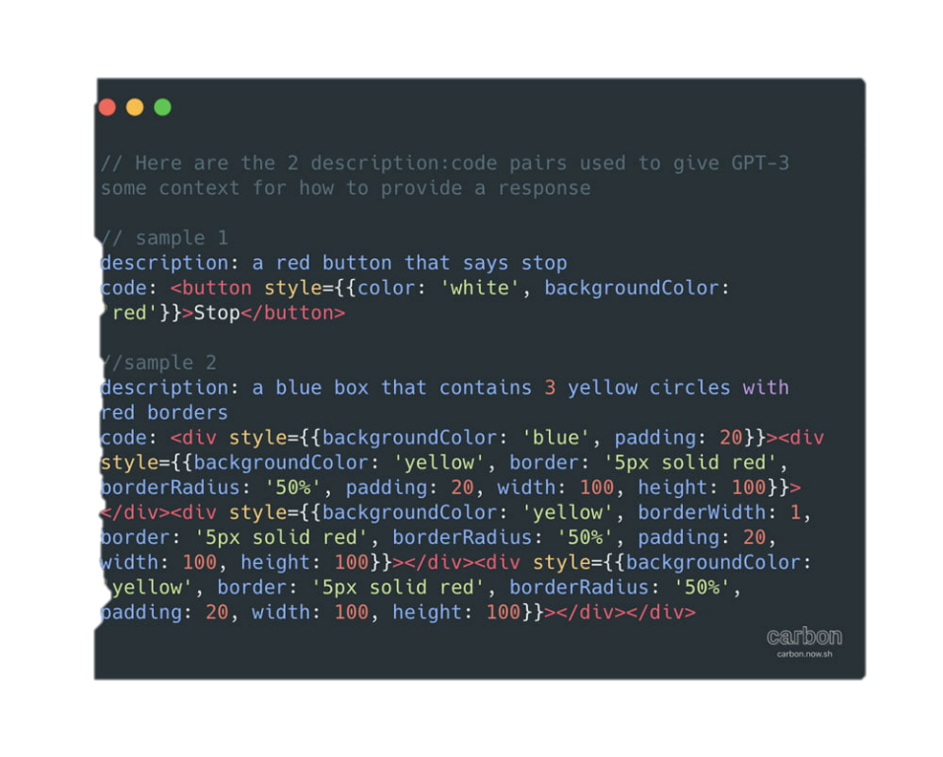
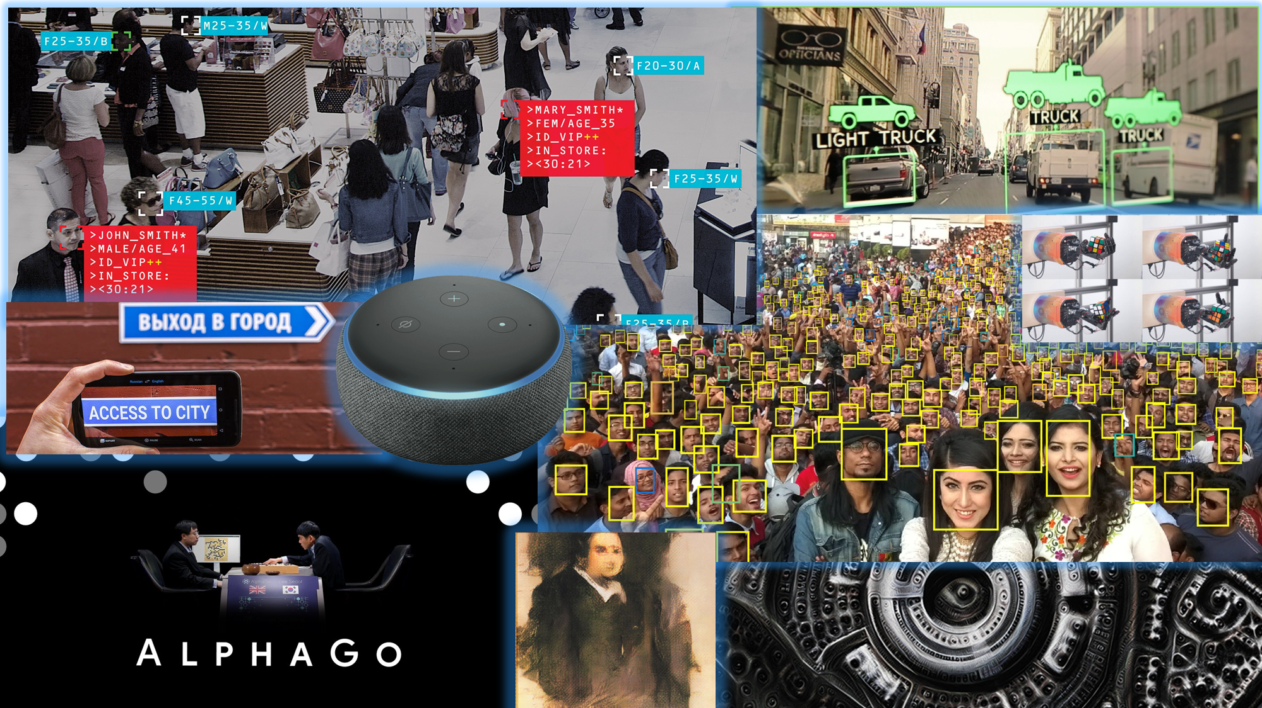

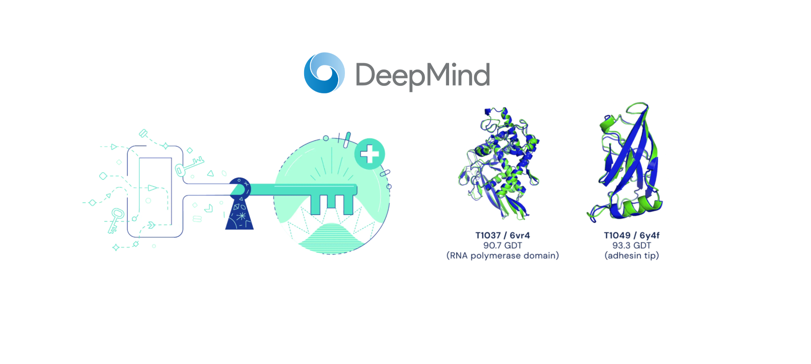

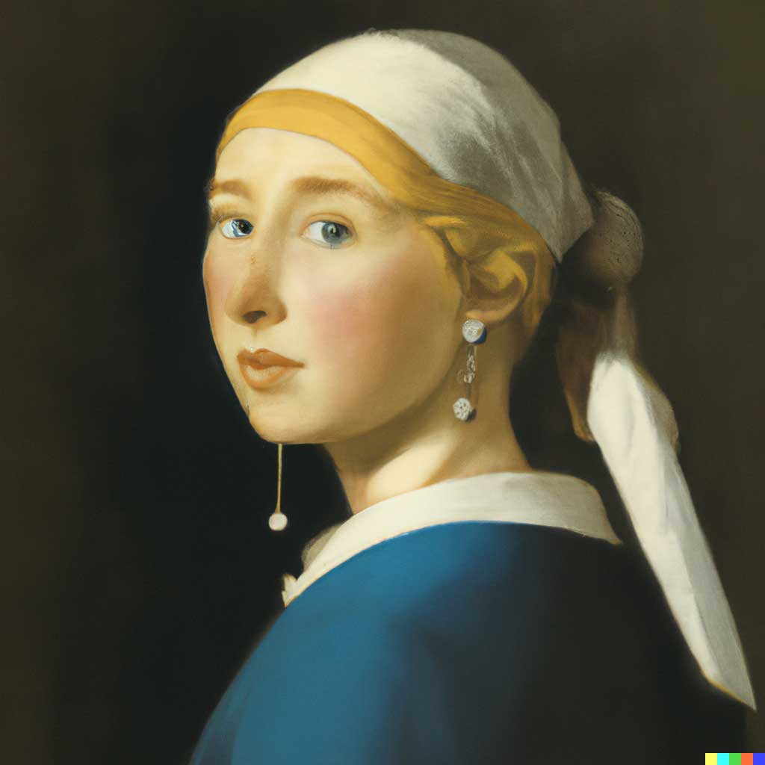
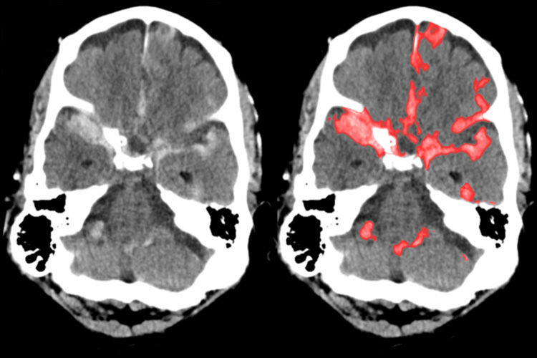
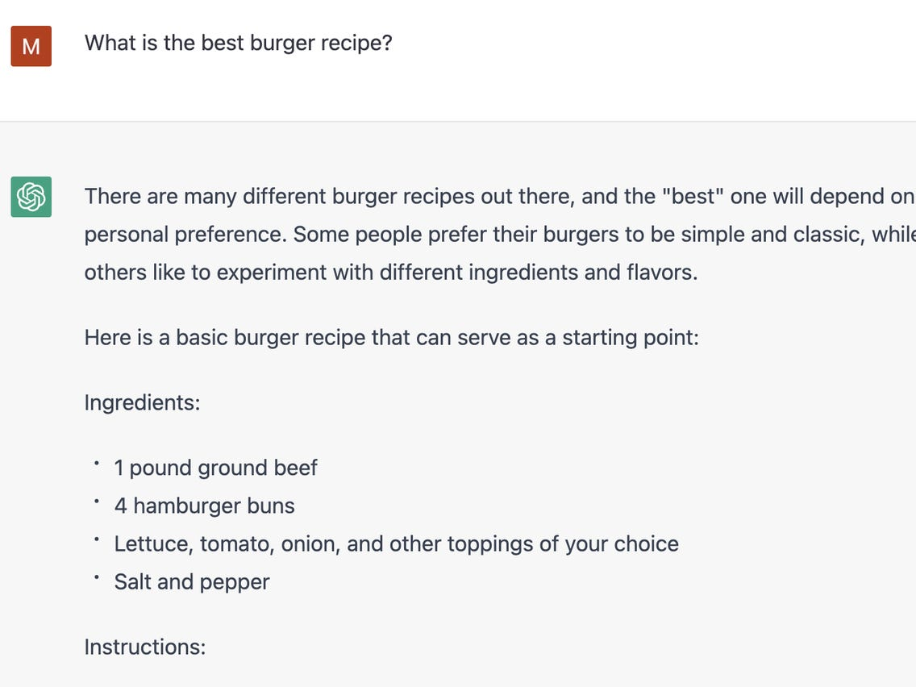

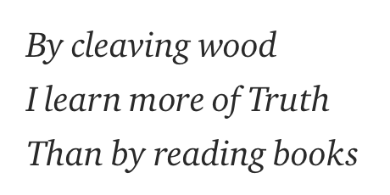
New Machine Learning methods are revolutionizing the world.

Slide 20

simple
building
blocks
neurons
increasingly
complicated
architectures

Slide 21
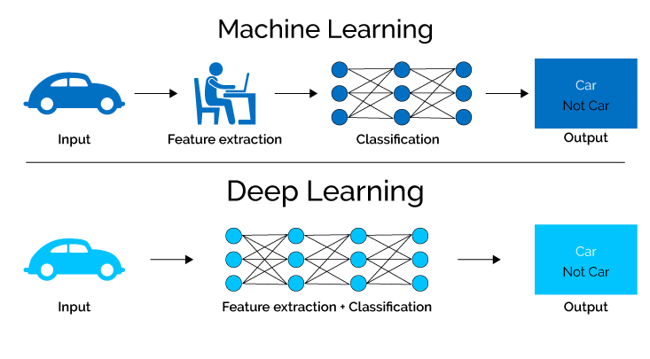


Slide 22

HOW?
WHY?
Model
Development
Model
Interpretation

Slide 23

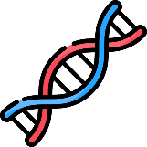








Monday
Tuesday
Tuesday
Wednesday
Wednesday
Thursday
Friday
Intro to Genomic Data
Intro to Explainability
Computer Aided Drug Design
Breakthroughs and Challenges in Multi-omics
Browsing Genes and Genomes with Ensembl
Deep Learning for Genomics
Explainable Artificial Intelligence (XAI)
Molecular Representation and Random Forests
Dissemination and Communication of Research
Gene regulation discovery in the era of 3rd gen sequencing
ML for Drug Discovery
Explainability for Deep Neural Networks
CNNs for genomic annotation
DL for Protein Structure
Round Table:
Biomedical Research and AI
GitHub Repository
Panos Alexiou
panagiotis.alexiou@um.edu.mt
https://github.com/BioGeMT/MALTAomics-Summer-School

